Slide 1
Dealing with deans
Janet Kistner
FSU

Slide 2











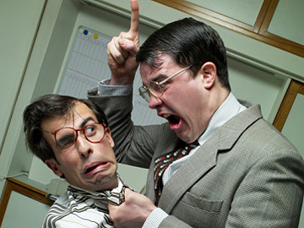

Slide 3
Complicated relationship
Chairs serve at the pleasure of the dean
Deans control chairs’ evaluation, salary, etc.
Deans control resources to departments
Bottom line: You can’t afford to have a bad relationship with your dean

Slide 4
Empowerment: dean depends on your success
Deans need to impress their “bosses”
serve at the pleasure of the provost/president
judged by effectiveness in meeting goals
most importantly – a flourishing, successful college
Success of a college depends on the success of its departments
Effective chairs are critical for successful departments

Slide 5
Tips for building effective relationships with Deans
Don’t let the budget go in the “red”
- if you’re headed for a budget shortfall alert your dean
ASAP
- provide a detailed explanation
- have a plan for getting back in the black

Slide 6
Tips for building effective relationships with Deans
2. Keep your dean informed (Goldilocks dilemma)
Good News? Send “good news” items periodically,
but for major successes make sure the dean is the 1st to know
Bad News? Balancing act between not “airing dirty laundry” and
allowing your dean to be blindsided
BLINDSIDED

Slide 7
Tips for building effective relationships with Deans
3. Use the dean’s time wisely
Provide an advanced agenda for a meeting
Come prepared (data, handouts, etc.)
Be clear about the desired outcome

Slide 8
Tips for building effective relationships with Deans
Present your dean in a positive way to your department (but if you are going to use dean as the “fall guy” give him/her a heads-up)
5. When requesting resources, put “skin in the game”

Slide 9
Tips for building effective relationships with Deans
Know how your dean prefers to be kept informed preferred mode of communication?
how frequently dean wants you to “check in”?
7. Keep the dean’s confidences

